Slide 1
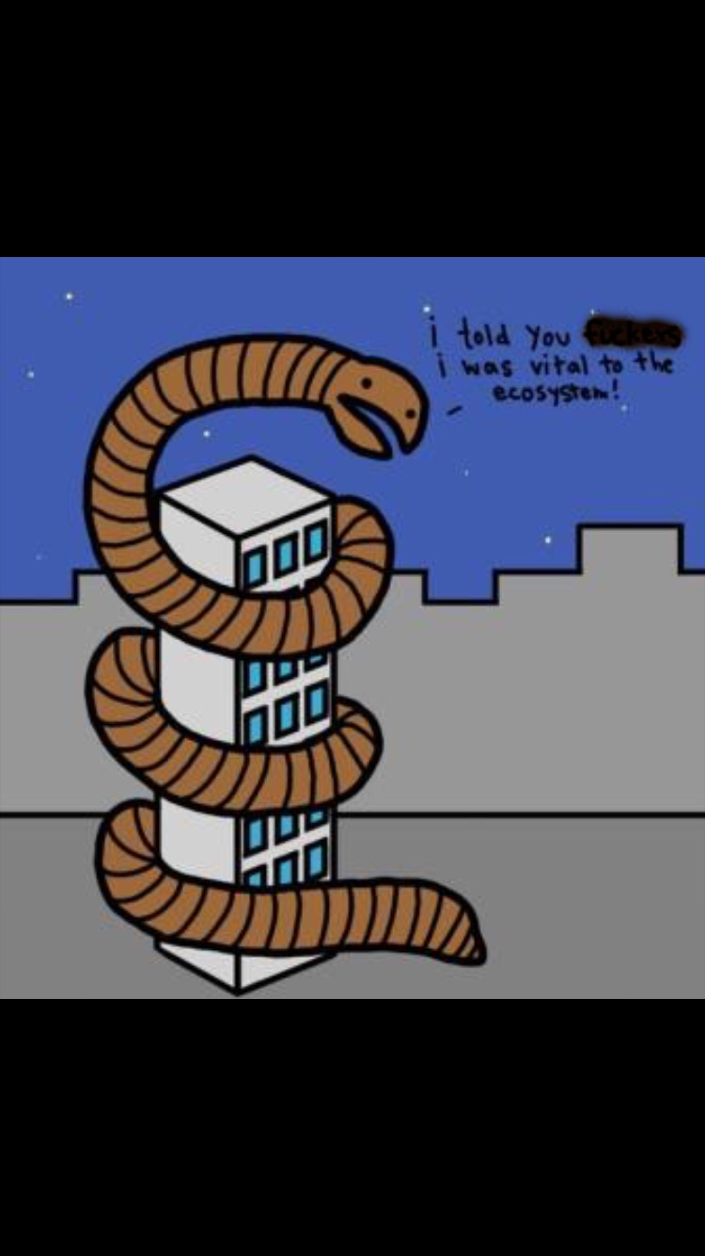
Ecosystems and restoration ecology
Sections 55.3 and 55.4

Slide 2
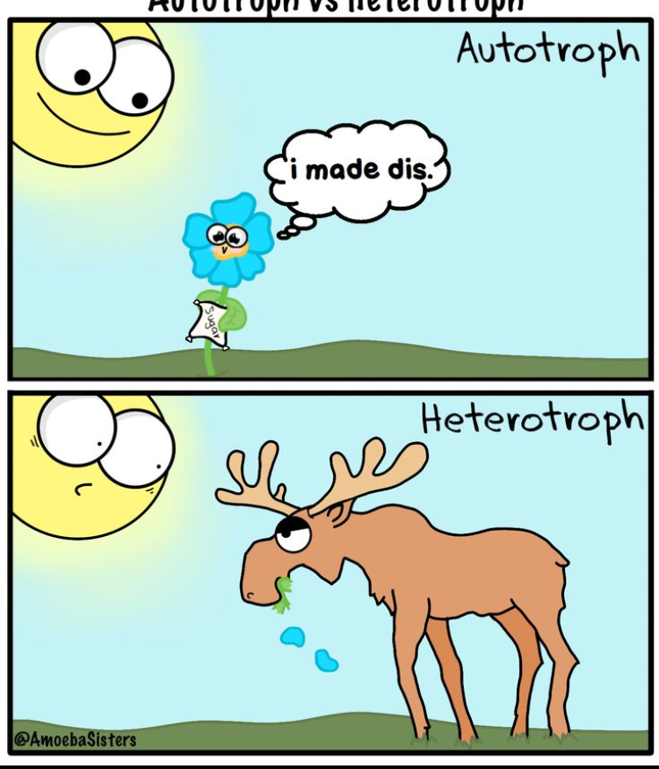
Early Energy transfer
When an organism eats another organism, not all of the energy gets transferred.
When a plant is eaten, it is estimated that only 1/6th of the producers biomass is converted into biomass of the consumer.
For example if a caterpillar were to eat a leaf, 1/6th of the leaf's energy would be put towards the growth of the caterpillar.

Slide 3
Loss of energy
Energy is lost in more ways than one. Energy is lost to:
Respiration
Heat
Feces
This is why Energy is said to flow through, not cycle within, ecosystems.

Slide 4
Production efficiency
We can measure the efficiency of animals as energy transformers using the following equation
Net secondary production represents the energy stored in biomass (or the energy used for growth and reproduction in an organism)
Assimilation represents the total energy taken in (not including loss for feces, growth, reproduction, and respiration)

Slide 5
Trophic efficiency
Trophic efficiency is the percentage of production transferred from one trophic level to the next.
Trophic efficiencies are generally only about 10% and range from approximately 5% to 20% depending on the type of ecosystem. In other words, 90% of the energy available at one trophic level typically is not transferred to the next.
This loss is multiplied as the food chain increases.

Slide 6
Ecological pyramids
The loss of energy with each transfer in a food chain can be represented by a pyramid of net production in which the trophic levels are arranged in tiers.
The width of each tear is proportional to the net production and is measured in joules.
The reasoning for most biomass pyramids sharply narrowing at the top level consumers is directly connected to the energy transfer being so inefficient between ecosystem.

Slide 7
Ecological pyramids
While most ecological pyramids have a sharp format, aquatic animals sometimes defy this as they have more consumers, but their producers have a faster turnover time.
Having a short turnover time means that the standing "crop" is small compared to its production.
To measure this we use the turnover formula
However, the pyramid of production is still bottom heavy in aquatic life.

Slide 8
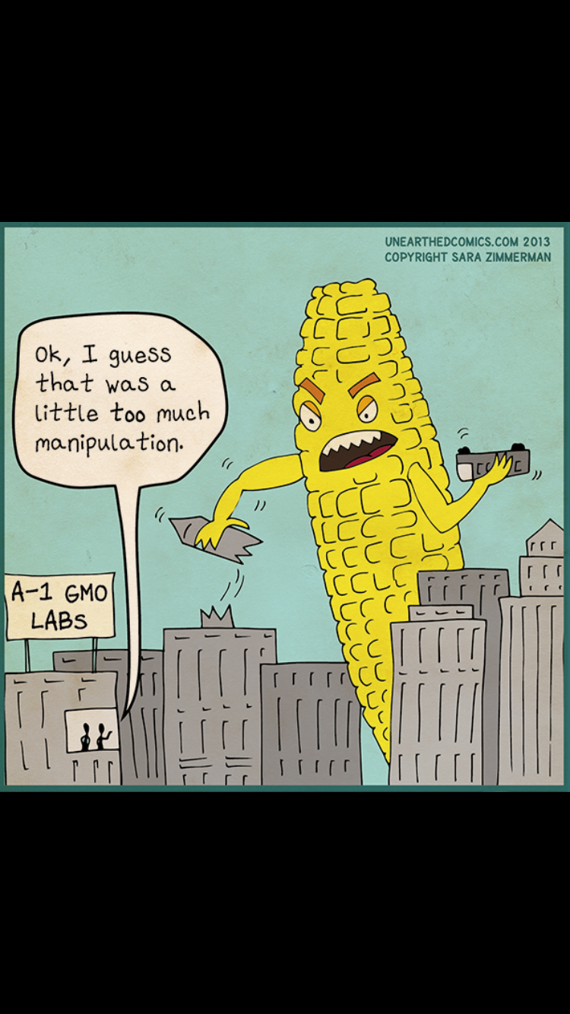
CHAPTER 55 section 55.4
BIOLOGICAL AND GEOCHEMICAL PROCESSES CYCLE NUTRIENTS AND WATER IN ECOSYSTEMS

Slide 9
Recycling elements
All chemical elements on Earth are available only in limited amounts, therefore must be recycled throughout the atmosphere.
Much of an organisms chemical stock is replaced continuously as nutrients are assimilated and waste products released.
Once an organism dies, the atoms and it's complex molecules are returned into simpler compounds to the atmosphere, water, or soil by the action of decomposers.
Because nutrient cycles involve both biotic and abiotic components, they are called biogeochemical cycles.

Slide 10
Biogeochemical cycles
Life gets chemical elements through recycling old life.
There are two general categories for biogeochemical cycles: global and local.
Gaseous forms of carbon, oxygen, sulfur, and nitrogen occur in the atmosphere, and a cycles of these elements are essential globally.
Other elements, including phosphorus, potassium, and calcium, are too heavy to occur as gases at earths surface.

Slide 11
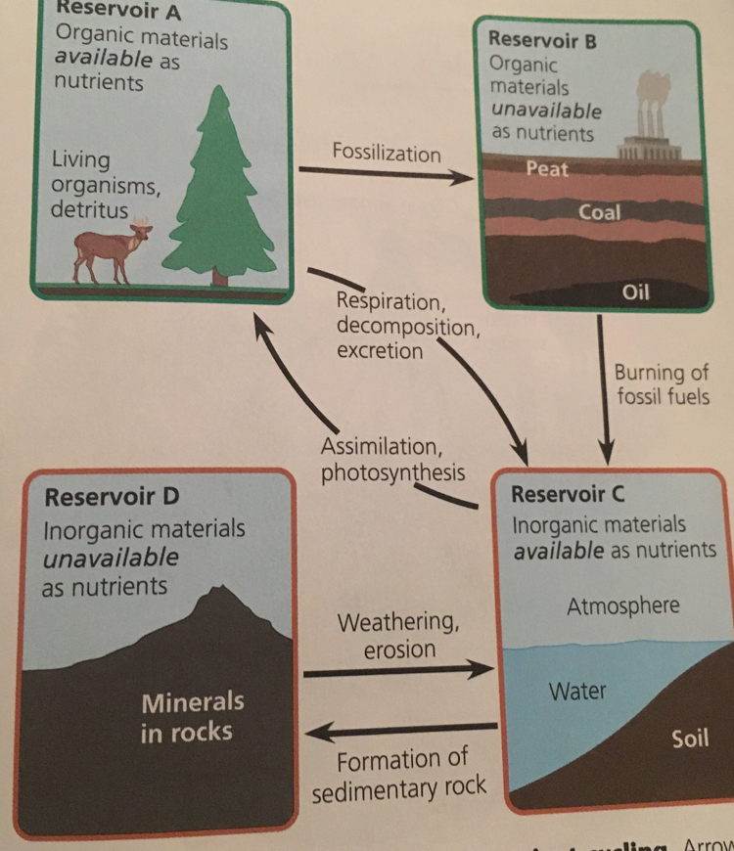
Biochemical cycle
These examples of reservoirs show how organisms cycle through Organic materials, nutrients, inorganic materials, and materials unavailable as nutrients.

